Slide 1

Product walkthrough & focused audit
Yaniv Yaakubovich

Slide 2
Today’s meeting
Goal
Align on where the product is today, surface the most painful challenges, and kick-off the discovery process
Structure
Clarify product thesis
Stress-test current plan,
co-create next 2–3 experiments.
Outcome
You’ll walk out with 2–3 concrete product bets worth testing in the next 2 weeks

Slide 3
Product snapshot (current reality, not future vision)
Quick Answers only. We’re optimizing for signal, not accuracy
Problem & who it’s for (segments, “best-fit” users)
<Your answer here>
Current traction & usage patterns
<Your answer here>
Top 1–2 product bets you’re making now
<Your answer here>
<Your answer here>

Slide 4
Quick demo
Let’s keep this to 5 minutes

Slide 5
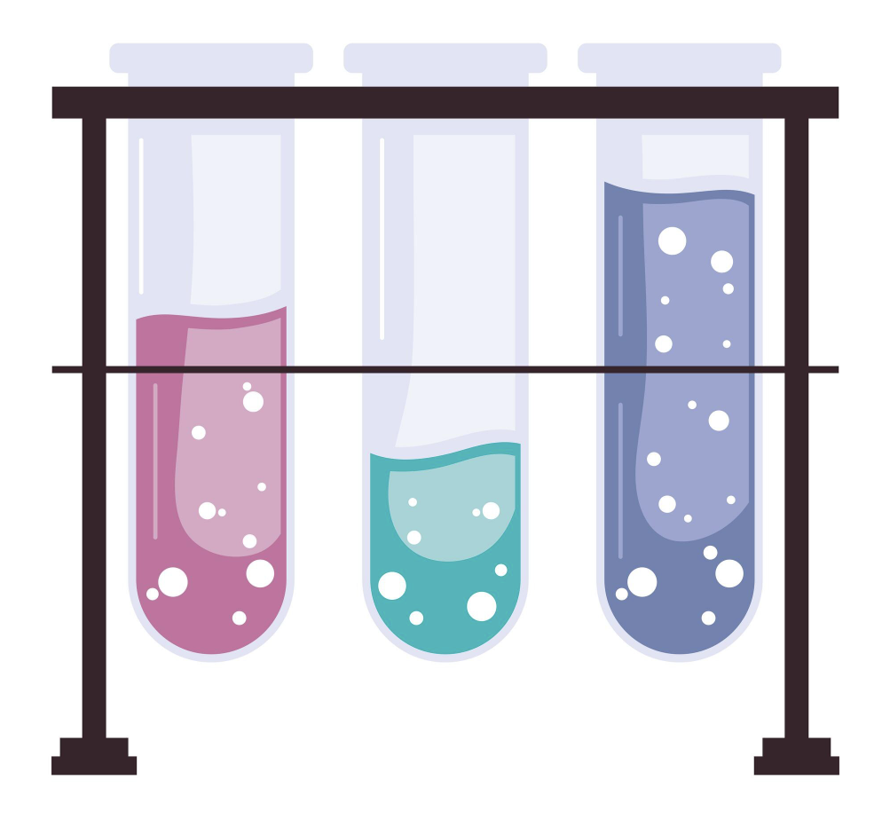
A valid product bet must answer
We will select no more than 3
What assumption are we testing?
What change are we making?
What signal would tell us we’re right or wrong?
Optional bets areas: Specific flow, GTM, Product process, Technology

Slide 6
Draft goals & direction (audit hypothesis)
If we’re successful, within 6 2-3 months we should be able to say:
<Your answer here>
Roadmap: Now (focus & stabilize). What must work before anything else?
<Your answer here>
Roadmap: Next (learn & validate). What we need to learn or validate?
<Your answer here>
Roadmap: Out of scope. What should we not work on yet?
<Your answer here>
Decision gate: We will leave this section with max 3 bets worth testing in the next 2 weeks.

Slide 7
Product & Engineering collaboration
This is where execution usually breaks not strategy
What are the gaps between engineering & product goals today?What causes them?
<Your answer here>
Where do tradeoffs get unclear?
<Your answer here>

Slide 8
Agreed product bets (next 2 weeks)
Based on today, we’ve agreed on 2–3 bets worth testing.
(Example) Funnel improvement
<Your answer here>
(Example) Improve onboarding
<Your answer here>
(Example) AI product - Simplification
<Your answer here>

Slide 9
https://inenglishplease.onrender.com/

